Slide 1
A Computational Systems Neuroscience Perspective on Interacting Memory Systems
Randall C. O’Reilly
UC Davis, eCortex Inc, Astera Obelisk Lab

Slide 2
Three Major Questions
1. Do hippocampal place fields directly support spatial navigation?
2. Is the hippocampus a predictive learning system?
3. What are sources of forgetting in hippocampus and neocortex?

Slide 3
Three Major Questions
1. Do hippocampal place fields directly support spatial navigation?
No – parietal lobe does, hippocampus takes episodic snapshots of locations.
2. Is the hippocampus a predictive learning system?
No – episodes cannot be predicted – cortex does predictive learning at semantic level.
3. What are sources of forgetting in hippocampus and neocortex?
Initial transient decay of synaptic plasticity – after 1 day, interference.

Slide 4
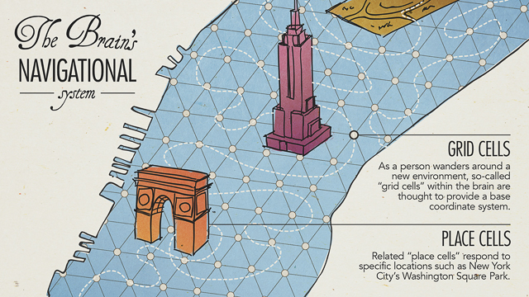
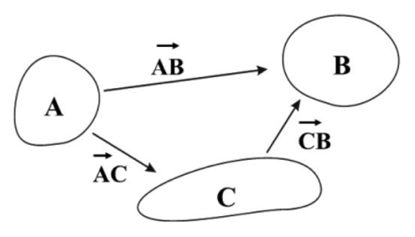
Space -> Navigation in the Brain
EC = entorhinal cortex
HC = hippocampus
The “Standard Model”: EC and HC essential for navigation
(e.g., Nobel prizes, 2014 for O’Keefe & Mosers)

Slide 5
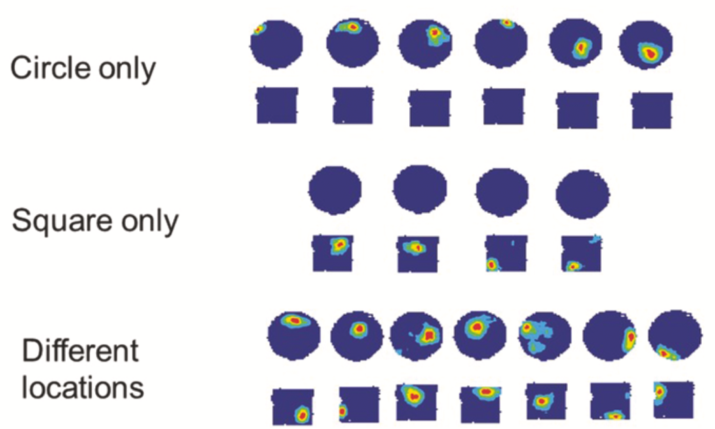
Hippocampal place fields “remap”
There is no consistent “language” for space in HC
Imagine if your Nav program talked to you in a different language every time!

Slide 6
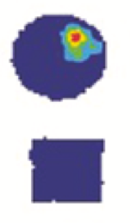
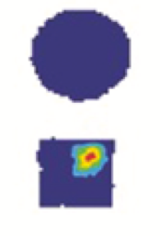
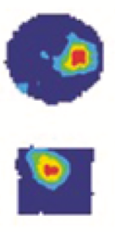

“I want to go up, left”
Sure, let’s see.. uhh, are you in a round or square room, with a white or black card, with a window here or there, with this or that goal…..….. ad infinitum?
Place fields are great for remembering specific details
but terrible for a general-purpose representation of space!
Space in HC is represented differently in every different place – there is no consistent representation of space!
Practically: you have to decode place cells separately in each and every different room – how is rest of rat’s brain decoding HC output? Same cells fire in every different location..

Slide 7
Lesion Data?
HC: Little evidence of navigation deficits independent of memory (Eichenbaum & Cohen, 2014; Ekstrom & Ranganath, 2017)
EC: lesions have surprisingly little effect overall (on place cells, on navigation, etc)

Slide 8
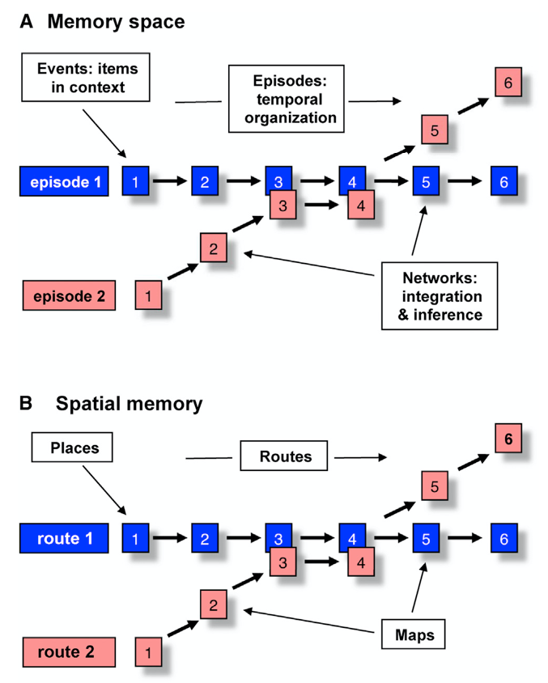
Hippocampus / MTL is for Memory (Eichenbaum & Cohen, 2014; Ekstrom & Rananath, 2017)

Slide 9
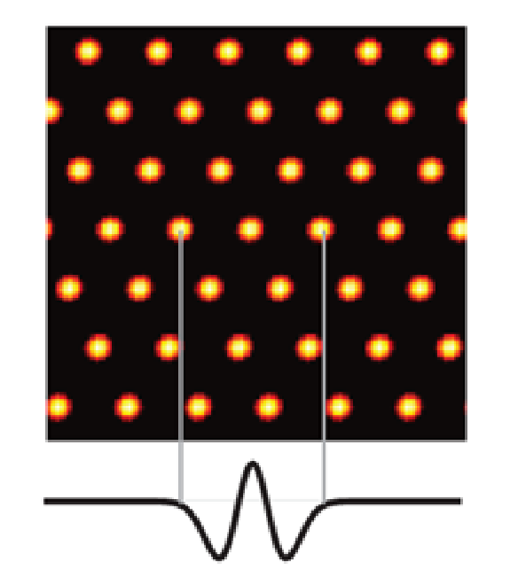
Grid Cells?
Standard model:
Continuous Attractor (Burak & Fiete, 2009): grid imposed by classic “mexican hat” lateral conns, with uniform velocity input.
Essentially a “symmetry breaking” pattern formation w/ all neurons receiving same input!
Only works w/ uniform input – not a general-purpose spatial code.
Many sources of error: Rueckemann et al, 2020
In sum: grid cells might help with path integration, but not general-purpose “base coordinate system”!

Slide 10
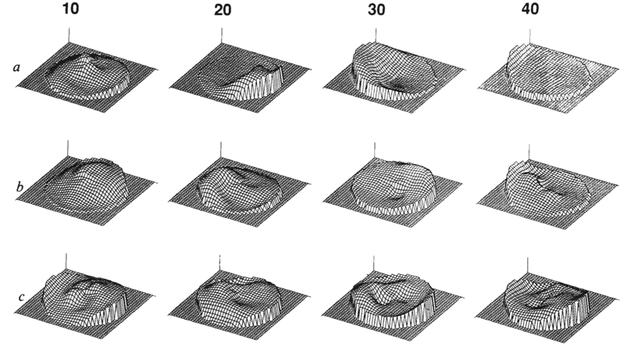
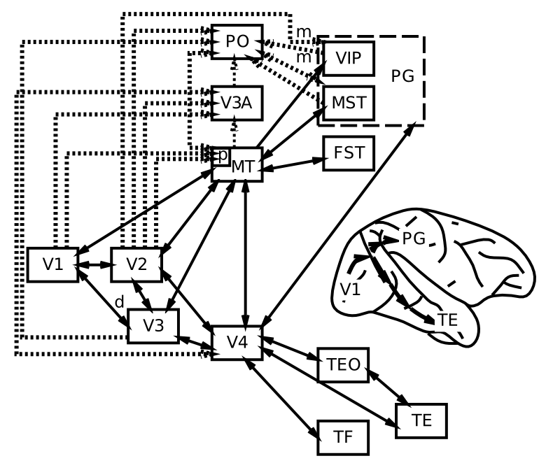
Parietal Lobe is for Space!
Ungerleider & Mishkin, 1982
LIP / IPL: R. Andersen et al
Pouget, Snyder, Zipser: smooth spatial basis
(and action: Goodale & Milner, 1992..)

Slide 11
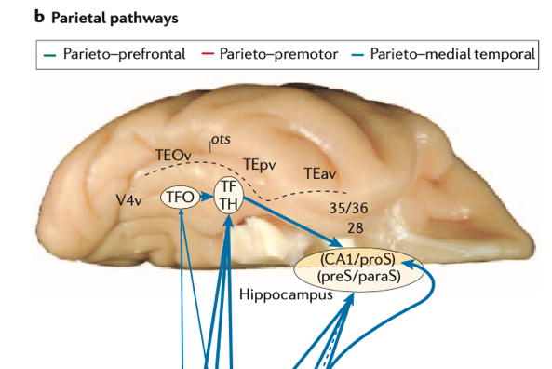
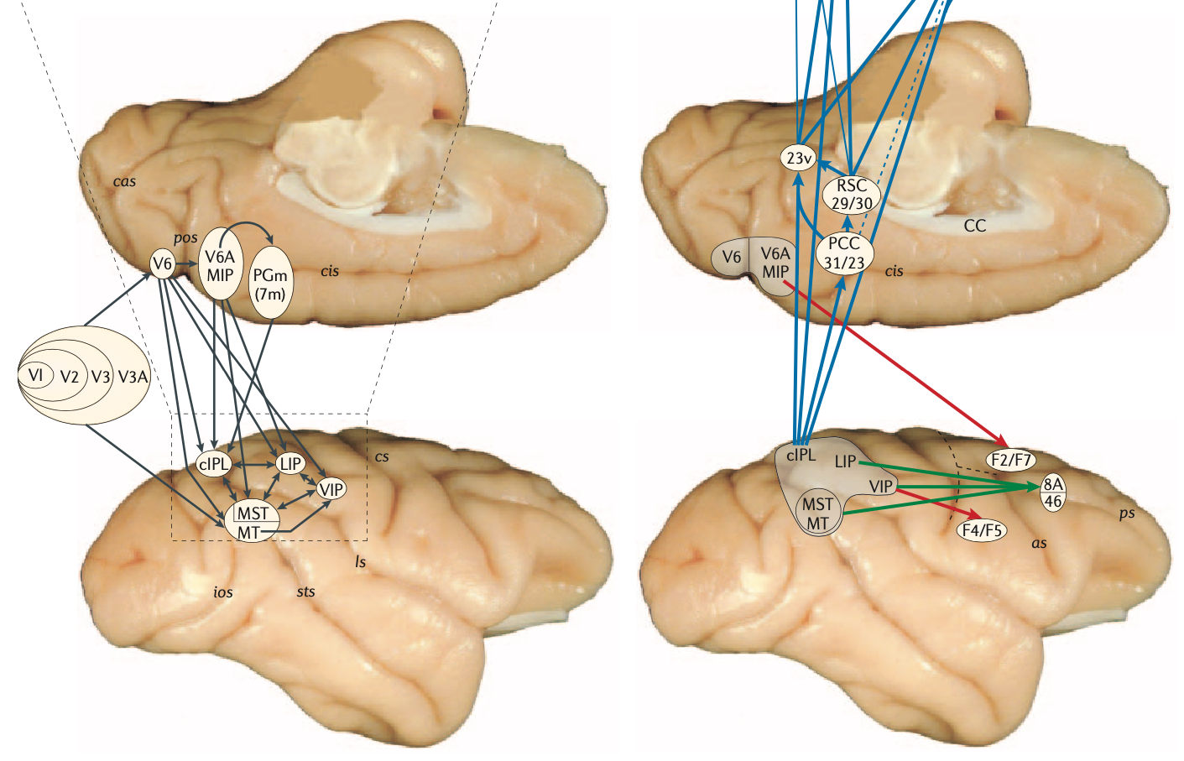
Three Parietal Pathways (Kravitz et al, 2011)
Looking (parieto-prefrontal)
Reaching (parieto-premotor)
Navigating (parieto-medial)

Slide 12
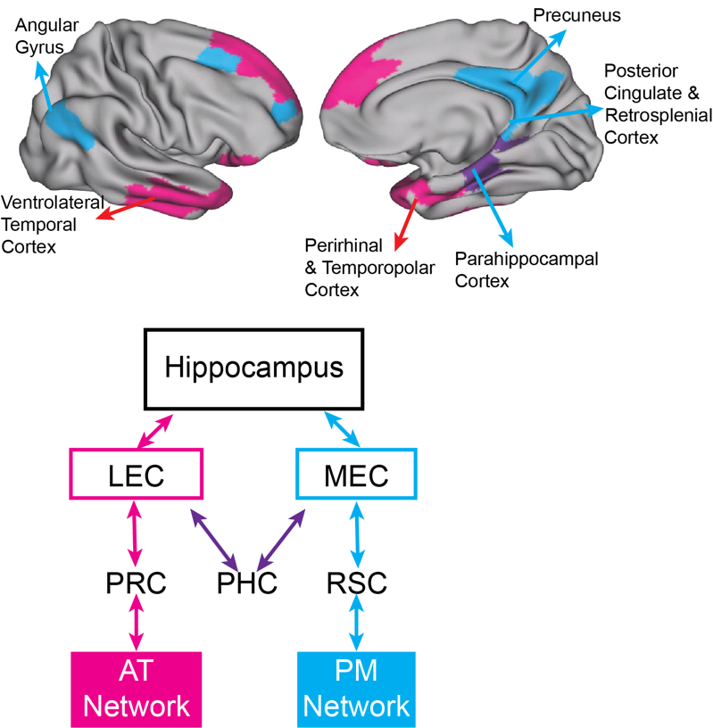
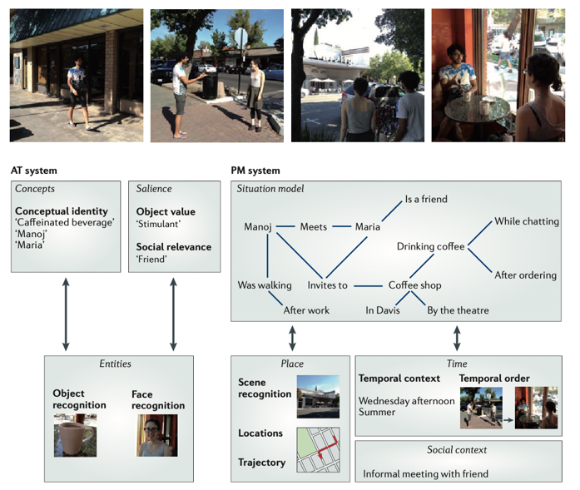
PM / AT Networks (Ranganath)
Ranganath & Ritchey, NRN (2012)

Slide 13
Episodic memory and the hippocampus
Dominant theory, extensive data (e.g., HM): Hippocampus binds temporal context and other content to form distinct, pattern separated representations of episodes (events)
Each hippocampal representation is unique, distinct from all others (i.e., a “hash code” of the event, like a QR code on your phone)

Slide 14
Is the Hippocampus a Predictive Learner?

Slide 15
Long history of predictive theories
Gray, 1982; Vinogradova, 2001; Lisman & Grace, 2005: scalar mismatch between prediction and actual:
“it is proposed that … the septo-hippocampal system (SHS) acts as a comparator: it compares predicted to actual sensory events and activates the outputs of the BIS when there is a mismatch or when the predicted event is aversive”
Levy, 1996; Wallenstein & Hasselmo, 1997; Jensen & Lisman, 1996; Tsodyks et al, 1996; Rolls, 2013; Schapiro et al, 2017; Stachenfeld et al, 2017: predict next step(s) in sequence:
“We argue instead that the [hippocampal] map is essentially predictive, encoding expectations about an animal’s future state. This view resonates with earlier ideas about the predictive function of the hippocampus [lots of additional cites]

Slide 16
Can you predict unique events?
Hippocampus cannot generate predictions because it has a highly reduced representation of lots of randomly related info and its job is to pattern separate to encode unique memories of even similar events.
By definition, unique events are not predictable!
Instead, sensory cortex can predict what happens next because: a) physics, b) it has extensive, systematic encoding of current and recent prior state at multiple levels of abstraction.

Slide 17
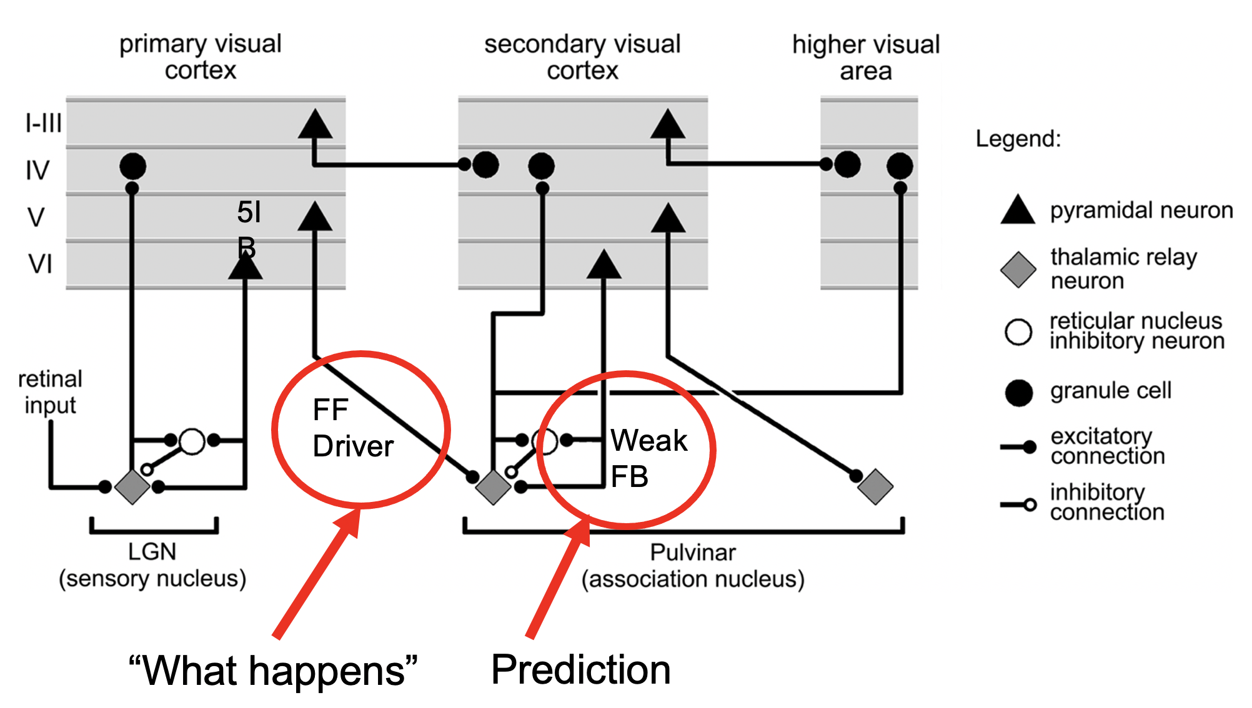
Predictive learning in Neocortex & Pulvinar (O’Reilly et al, 2021; JOCN)
Pulvinar!

Slide 18
Multimodal Action-Cued Predictive Learning in Parietal Pathways
Multimodal sensory prediction: full field depth, foveal vision, somatosensory (whiskers, vestibular), body state (thirst, hunger)
Error-driven predictive learning based on action: predict next state
New fully spiking error-driven learning (bio backprop) model!

Slide 19
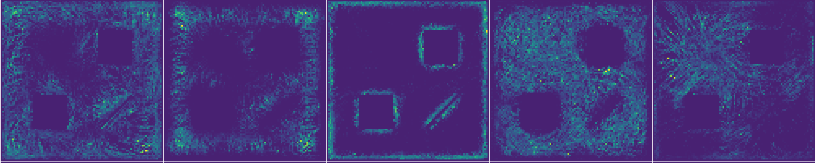
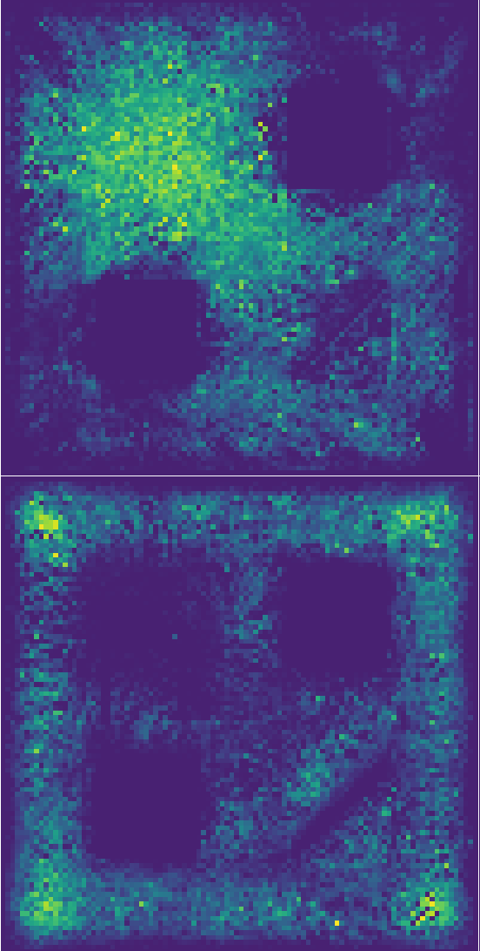
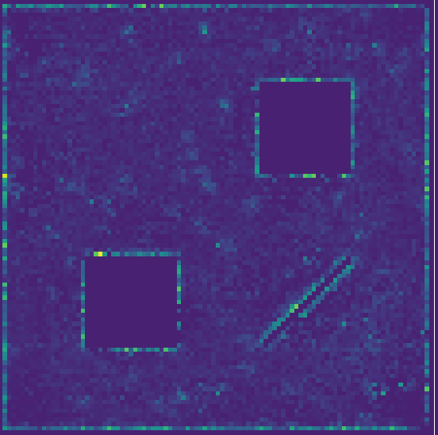
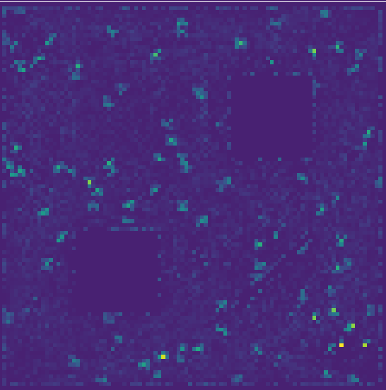
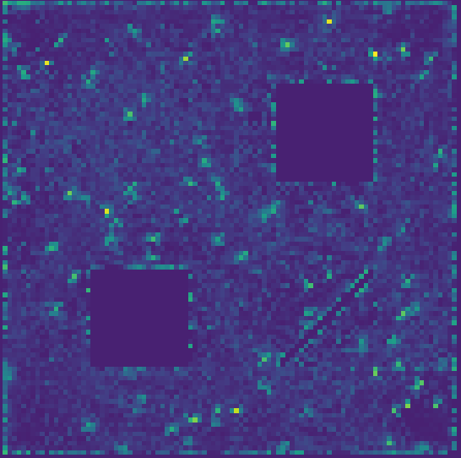
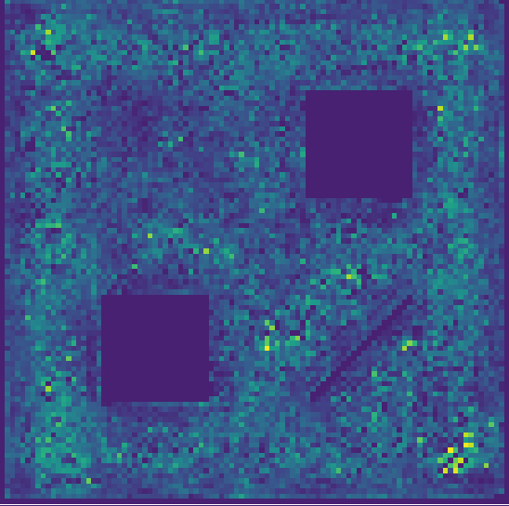
Computational Model Results
MST
PCC
SMA
Clear progression from MST to PCC to SMA: visual flow, borders to more action modulated (consuming spots).
Provides rich tapestry of representational bases for behavior.

Slide 20
But what about preplay in rodents?
Turns out it is mostly retrospective, not prospective..
Gillespie et al & Loren Frank (2021): Hippocampal replay reflects specific past experiences rather than a plan for subsequent choice:
“hippocampal replay does not reliably relate to immediately subsequent choice in a spatial memory task. Instead, replay preferentially represents previous goals and places that have not been visited recently, suggesting a role in storing and updating memories rather than in directly guiding upcoming behavior.”

Slide 21
Reward Prediction Error (RPE; DA) -> Hip
Even if Hippocampus does not generate prediction error, can be sensitive to it!
Sinclair et al & Barense (2019, 2021): Prediction errors disrupt hippocampal reps and update episodic memories.
Review: Ergo, De Loof & Verguts (2020): extensive evidence for RPE effects on “declarative memory”

Slide 22
Prediction error signals event boundaries?
Zacks et al (2007):
“Perceptual systems continuously make predictions about what will happen next. When transient errors in predictions arise, an event boundary is perceived”

Slide 23
Novelty, Recall, Event Segmentation, etc
Hippocampus can easily signal familiar (recalled) vs. not: novelty OK. (it just has no idea what will happen next..)

Slide 24
Interim Summary
Hippocampus is an episodic memory system, binding spatial, event, and content information into unique “hash coded” pattern separated representation.
Unique representations do not support prediction (unique = unpredictable!)
Each environment has unique spatial “map” – i.e., no map of any use at all! A map with unique topology essentially has no topology until decoded.
Predictive learning in the parietal lobe can develop systematic, low-dimensional, graded representations supporting spatial navigation.
Based on thalamocortical loops?

Slide 25
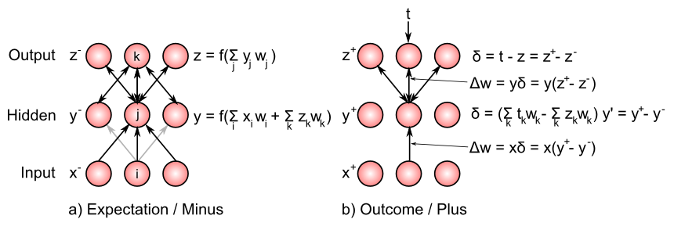
Two Sources of Forgetting
1. Synaptic weights are constantly changing whenever neurons are active across the synapse! This results in constant ongoing interference.
2. Transient changes prior to more permanent protein-synthesis dependent aspects of synaptic plasticity (stable after 24hr or so)

Slide 26
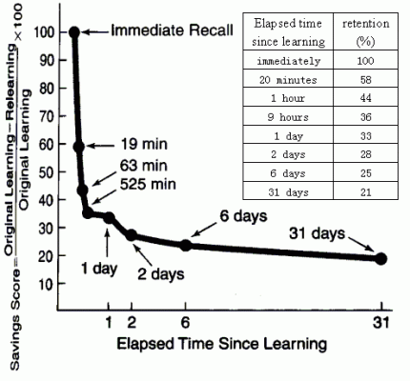
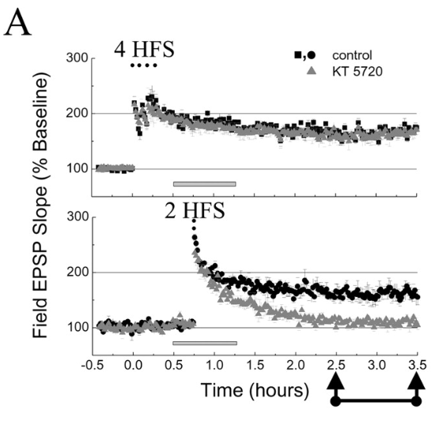
Memory Retention: Decay / Interference

Slide 27
Dynamics of Synaptic Forgetting
Across learning, shared synapses are strengthened, distinct are weakened, resulting in “semanticization” of traces.
Happens in neocortex and hippocampus
Learning old pattern with new “goal / plan” component can produce more interference vs. previous goal / plan: potential “no think” effect?

